Slide 1

Intro to JavaScript Tooling in Visual Studio Code
November 9, 2015
MadJS

Slide 2





About me and this talk
Scott Addie
.NET Solutions Architect
MCSD (Web Apps)
Visual Studio Code Insider
GitHub.com/scottaddie
ScottAddie.com
@Scott_Addie
LinkedIn.com/in/scottaddie

Slide 3



About VS Code
An editor, not an IDE
Based on GitHub’s Electron shell
Designed by engineers who created:
Eclipse @ IBM
Monaco @ Microsoft
Launched at //Build/ conference on April 29th
Lightweight
Cross-platform

Slide 4
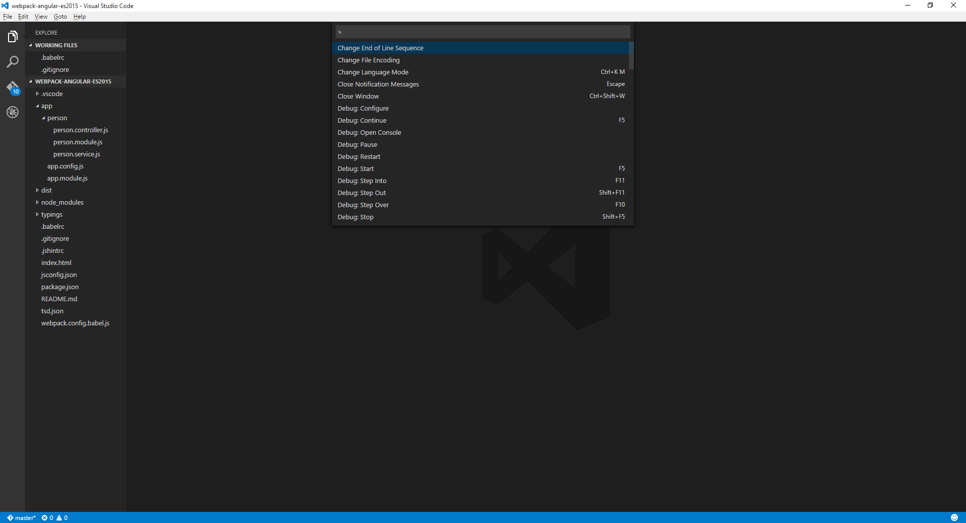
A Quick Tour of the Editor
Ctrl + Shift + E
F1
or –
Ctrl + Shift + P
Ctrl + Shift + F
Ctrl + Shift + G
Ctrl + Shift + D

Slide 5

Demo
let demo = + ;
Using VS Code for JavaScript Development

Slide 6

Resources
Scan QR for slides:
Official VS Code website
VS Code Docs
Visual Studio Code
John Papa, Pluralsight course
VS Code ES6 Sample Project
GitHub repo

